Slide 1

GIGABIT EHERNET
13.1
Copyright © The McGraw-Hill Companies, Inc. Permission required for reproduction or display.

Slide 2
13--55 GIGABIT ETHERNET
The need for an even higher data rate result in the
design of the Gigabit Ethernet protocol (1000 Mbps).
Topics discussed in this section:
MAC Sublayer Physical Layer
Ten-Gigabit Ethernet

Slide 3

Note
In the full-duplex mode of Gigabit Ethernet, there is no collision;
the maximum length of the cable is determined by the signal attenuation in the cable.

Slide 4
Note
Half Duplex mode can be achieved by three methods:
Traditional
Carrier Extension
Frame Bursting

Slide 5
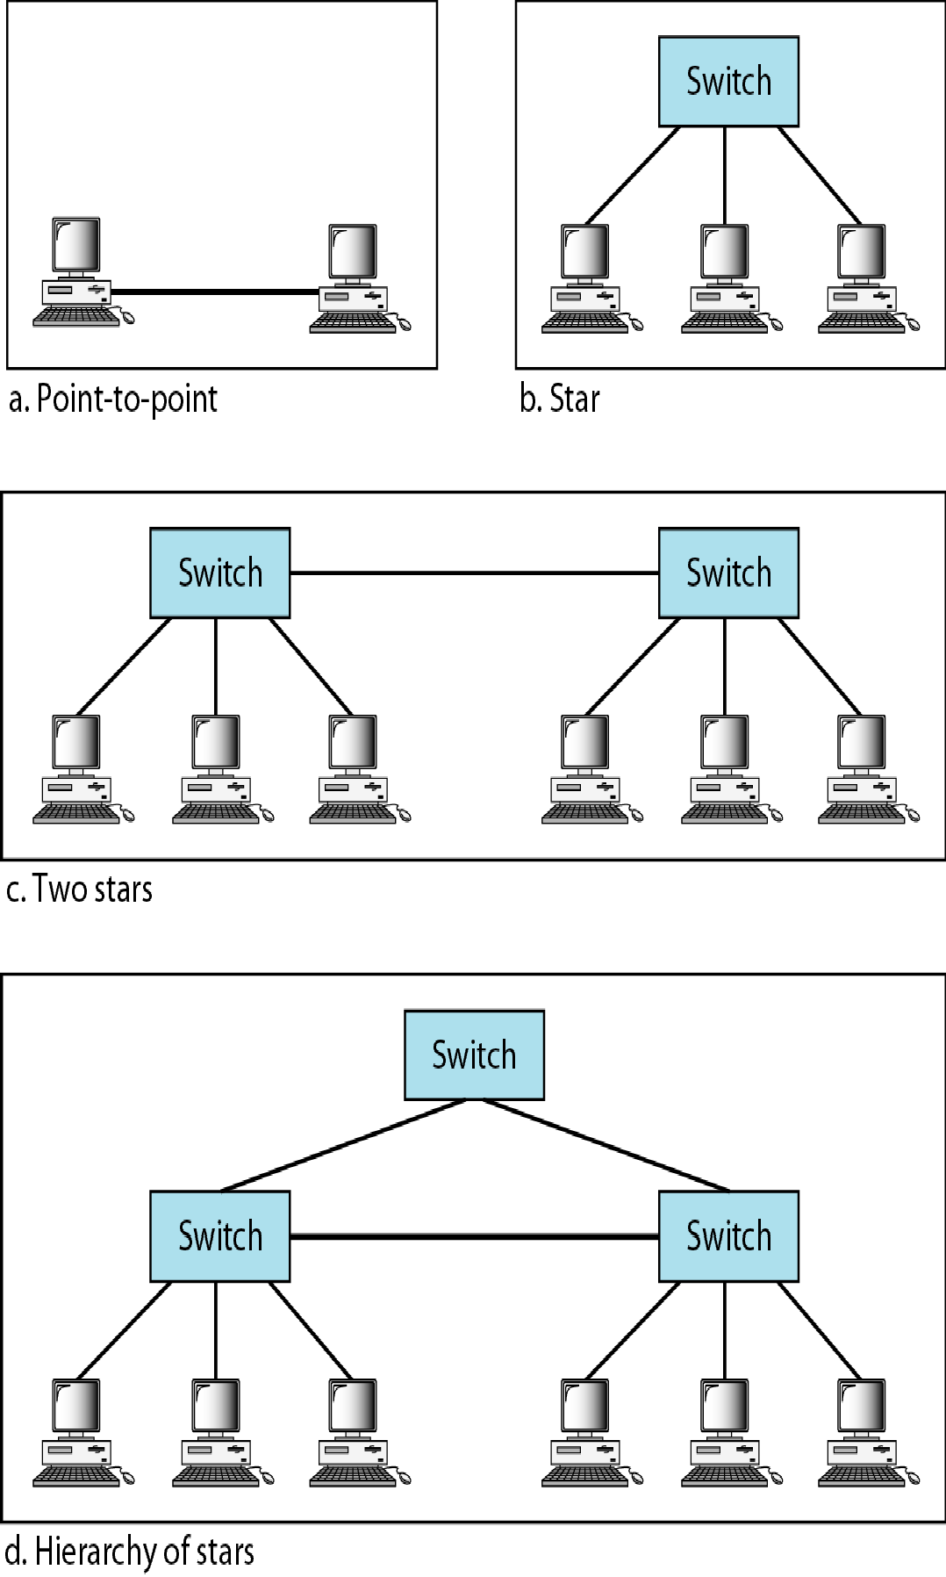
Figure 13.22 Topologies of Gigabit Ethernet

Slide 6
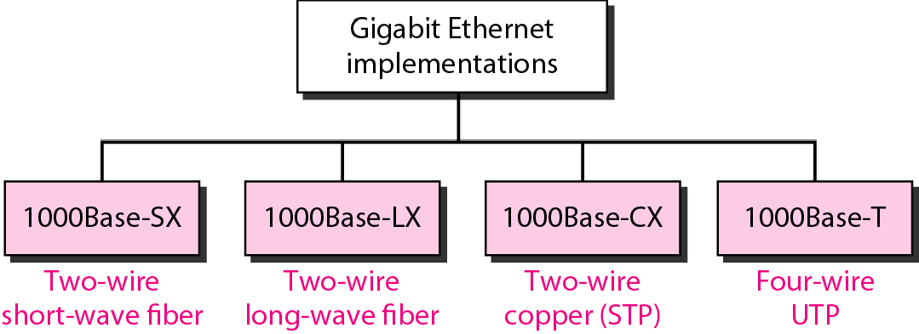
Figure 13.23 Gigabit Ethernet implementations

Slide 7
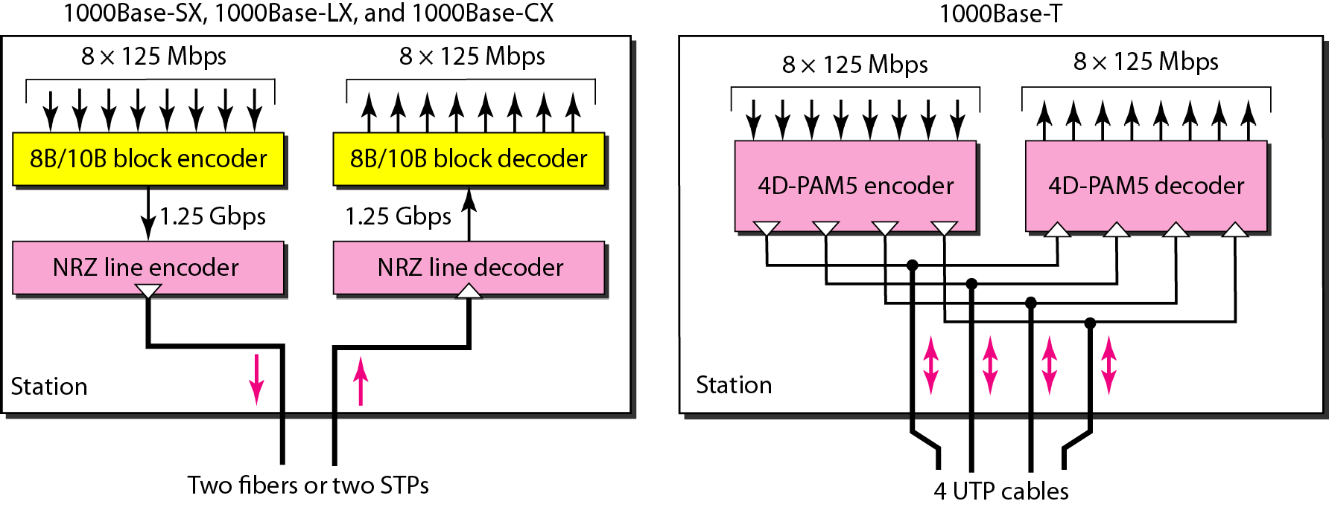
Figure 13.24 Encoding in Gigabit Ethernet implementations

Slide 8
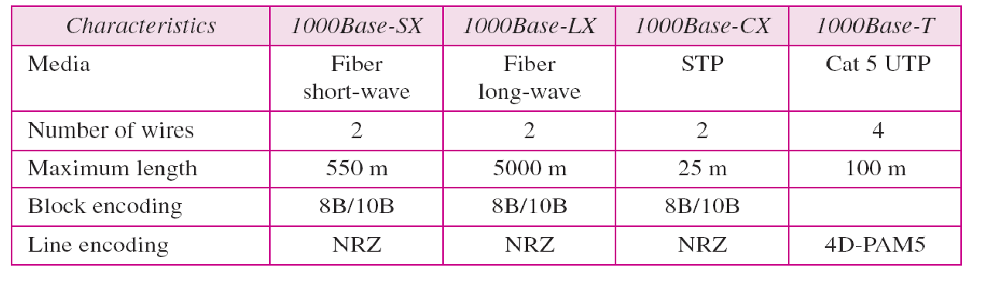
Table 13.3 Summary of Gigabit Ethernet implementations

Slide 9
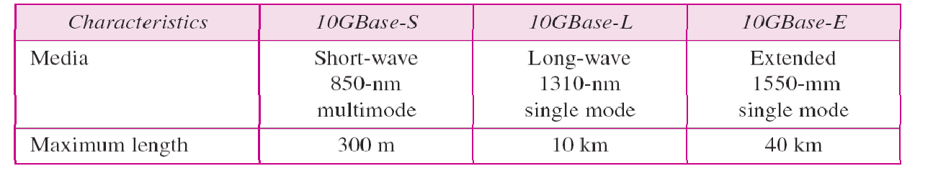
Table 13.4 Summary of Ten-Gigabit Ethernet implementations

